Slide 1

ONE TEAM IN ACTION
United in purpose, driven in practice.
Sunday June 28th - Cranfield University

Slide 2









Building financial resilience by growing clinical services
Increase Income. Build clinical skills. Learn from specialist peers.

Slide 3

Thousands of digital health solutions have entered the market in the last 10 years but very few have successfully integrated into everyday pharmacy practice
We’ve never had more access to digital health tools yet behaviour change and long-term condition outcomes remain one of the biggest challenges in healthcare.
The Result

Slide 4

Why are we here this evening, and what would we like you to consider?
We’re here to explore how growing clinical services can create real financial resilience and what practical models exist today to help you start doing that
The Result

Slide 5

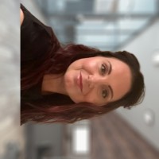
Introductions
Dr Milan Koya – Medical Director at Virtually Health Systems
Medical advisor for the Parliamentary and Health Service Ombudsman
The Result
Lucy Beazley – Head of Sales & Partnerships
Veteran, 23 years across Pharmaceuticals, Med Tech and SaaS
NHS Trust Governor

Slide 6
Virty’s Clinical Team
Our Clinical Psychologists
Our Clinical Psychologists are degree-qualified professionals with accredited training in Psychology, holding undergraduate degrees in Psychology and advanced clinical training. They are experienced in evidence-based approaches such as Cognitive Behavioural Therapy (CBT), behaviour change science, and structured therapeutic interventions. Their role within Virty is to support patients with mindset, emotional regulation, and sustainable habit change ensuring that clinical and lifestyle interventions are psychologically safe, structured, and outcomes-focused. This ensures patients are not simply given advice but are supported through clinically informed behavioural frameworks.
Our Health Coaches
Our Health Coaches hold a Level 5 Health Coaching Diploma which is considered the gold standard qualification within the UK health coaching profession and are accredited through recognised bodies such as the Health Coaching Academy. All coaches are trained in structured behaviour change methodology, motivational interviewing, goal-setting frameworks, and accountability models. Many also bring additional qualifications, including degrees in nutrition, exercise science, or full Personal Trainer accreditation. Their role is to translate clinical recommendations into practical, sustainable daily habits that patients can realistically maintain.
Our Nutritionists
Our Nutrition professionals are qualified in evidence-based nutrition science, with many holding degree-level education in Nutrition or related health sciences. They are trained to provide structured dietary guidance aligned to clinical best practice, metabolic health principles, and long-term weight management strategies. Their focus is not on short-term dieting, but on personalised, sustainable nutrition plans that support overall health outcomes, working collaboratively alongside our clinicians and coaches to ensure joined-up care.

Slide 7

Virtually UK: Clinically led. NHS aligned. Trusted to deliver.
Who we are
Virtually UK is a provider of clinical services and develops NHS accredited digital solutions.
200+ employees
Clinically grounded
We are established as a clinically led partnership with a proven track record of delivering NHS and private care
We build digital solutions designed with and for clinicians that integrate with NHS systems
NHS-approved digital solutions
We are established as a clinically led partnership with a proven track record of delivering NHS and private care
We build digital solutions designed with and for clinicians that integrate with NHS systems
The Result
Supporting integrated clinical care
Our solutions enable HCPs to collaborate in multi-disciplinary care teams that centre on the patient
We are backed by clinical and digital enablement, governance and technical expertise from our clinician and software teams
You can confidently partner with Virtually UK as your trusted clinical partner, providing governance, integration and support to deliver proactive care beyond your pharmacy counter

Slide 8

What is Virty?
A 24/7 doctor-led digital health service for continuous monitoring, proactive intervention and lifestyle support.
Virty is a clinically-governed platform that enables pharmacies to deliver and scale private clinical services safely and sustainably
We offer subscription plans that support patient across
weight management, mental wellbeing and several
Long-Term Conditions
It’s not about replacing what you already do
“That sounds great, but what is it going to cost me?”
Virty
Pharmacy
The Result

Slide 9
Introducing Virty: The Commercial Model
Lucy Beazley

Slide 10
Virty: Extending preventative care beyond the counter
What is Virty
Why is Virty different
Doctor Led Monitoring: for ongoing clinical oversight
Data with meaning: wearable and health metrics are
interpreted and actionable insights are provided
Proactive prevention: early intervention before problems escalate
Holistic care: such as lifestyle, nutrition and behaviour
change support
A circle of care: care is coordinated, not conflicting. Named clinicians are providing continuity and team-based care
Local, pharmacy-led marketing: tailored to your community, patient demographics and growth ambitions
Governance Support: Virty provides structured clinical governance with doctor oversight, prescribing responsibility, escalation of complex cases, and ongoing reviews, educing workload and removing risk for risk for pharmacists.
A 24/7 doctor-led digital health service for continuous monitoring, proactive intervention and lifestyle support.
We offer subscription plans that support patient across
weight management, mental wellbeing and several
Long-Term Condition
We offer subscription plans for real time continuous
monitoring of a patient and their families health for peace
of mind.
We turn health data into clinically actioned care.
Virty
Virty helps you provide wrap-around, clinically governed care that complements the trusted patient relationship.
Virty Health

Slide 11
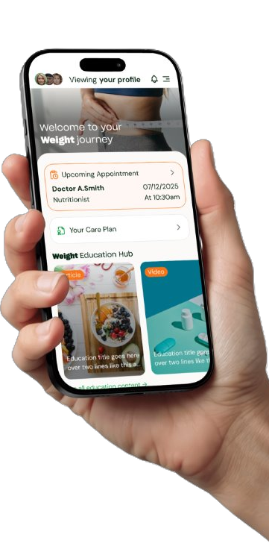
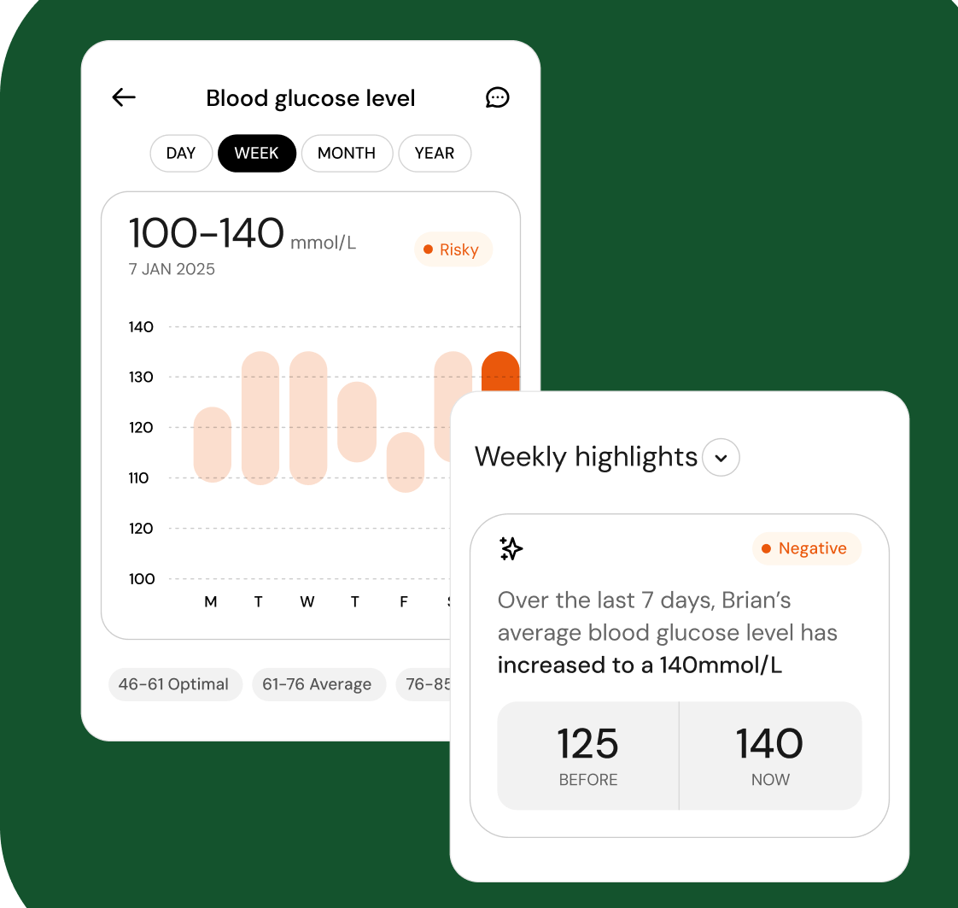
Virty Plans launched
A digital subscription where doctors monitor a patient’s wearable health data (e.g. heart rate, blood pressure) 24/7.
If anything, unusual is detected, a clinician reviews it and contacts the patient directly.
Ongoing medical monitoring and reassurance between GP appointments.
Health Protect
£45/month
Weight Journey
Express £8/month
Premium £38/month
​
A 12-month subscription plan​
Initial medical assessment, prescription and management plan.​
​
Local pharmacy plans include three in-person reviews per year. Doctor peer-review of pharmacist clinical reviews including change in agent or dose.
Lifestyle change support with Premium

Slide 12
Virty: The Commercial Model for Pharmacies
Pharmacy Role
Identifying patients who may benefit
Long-term Condition Plans
Health Protection
Weight Journey
Proactive doctor led health monitoring
Structured doctor-led care and lifestyle support
Ongoing condition specific support
​
Express ​£48 annual fee
Premium ​£72 annual fee
12-month contracted patients​
Governance framework​
Locally tailored marketing support​
£75 Commission Y1
£50 Subsequent Yrs
12-month contracted patients
Locally tailored marketing support
Pharmacy fees vary by plan.
Please arrange a meeting with Lucy Beazley for specific figures.
12-month contracted patients​
Governance framework
Locally tailored marketing support​
Pharmacy Role​​
Structured clinical reviews ​​
Pharmacy Role​​
Condition based clinical reviews​

Slide 13
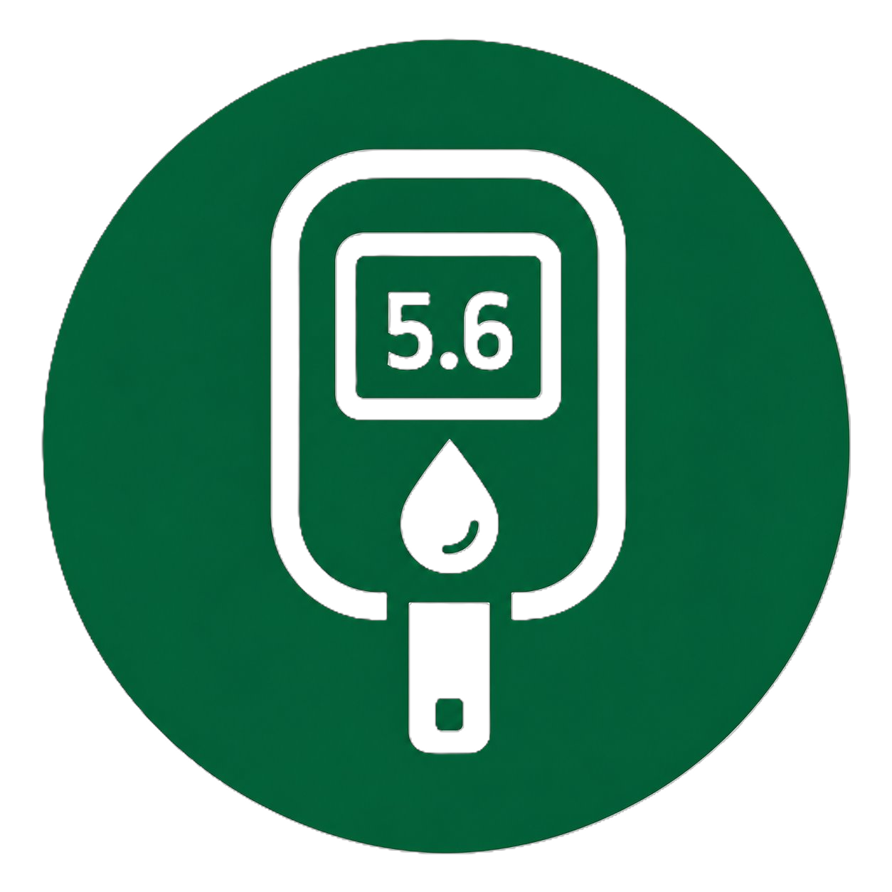



Virty Subscription Plans Launching
Two Consultant appointments (video)
Two pharmacist reviews (in-person)
Lifestyle change support with premium
Subscription price varies dependant on plan
Diabetes
Hypertension
Helping you take control of your blood pressure for a healthier heart and future
Mind +
Support for your mental wellbeing so you can feel better, everyday
Sleep Well
Better sleep for better days. We’re here to help you rest and recharge
Expert care and support to help you manage your diabetes with confidence
The Result
Monitor, Manage.
Live Well
Track, Support.
Protect
Feel Supported.
Live Balanced
Rest Better
Live Better

Slide 14
GP PLAN
Same-day GP access, every time
£20 per month
6
GP Plan enables members to access Same Day GP Consultations. The plan benefits from 6 appointments per year with the added peace of mind that you get to see the same GP each time.
appointments per year
Same
Prescription fee included
6 appointments per year
Virty GPs can provide in-person consultation at suitable pharmacy sites
Prescriptions and written treatments plans are included in this plan
The added peace of mind that you get to see the same GP each time
GP every time

Slide 15




BLOOD TESTING
Digital results report
At-home and in-pharmacy blood testing – launching soon
Results and doctor interpretation delivered through the patient app
At-home testing
At home Blood Testing and or In pharmacy Phlebotomy
Tests bundled for specific health concerns e.g. fatigue or menopause
API integration with provider
Patient App detailing results and reports
Doctor interpretation of results
One off testing and testing linked to subscription plans
Convenient home testing kit, with results reviewed by a clinician
In-pharmacy phlebotomy
Professional blood draw at Kamsons pharmacy locations

Slide 16
How Virty works in practice
Patients may start their journey with Virty in different ways, but every patient follows the same safe, doctor-led pathway.
How patients begin with Virty
The Virty clinical pathway
1. In-pharmacy conversation
Pharmacist identifies suitable patients from clinical history or medication
Counter staff proactively engage patients
2. At point of collection
Counter staff attach Virty leaflet to medication bag
3. Targeted outreach
Pharmacist or manager identifies patients with LTCs
Pharmacy send Virty leaflet with covering letter
4. Patient-led enquiry
Patient responds to local advertising or contacts the pharmacy directly
1. Clinical assessment and care plan
Virty doctor completes assessment and sets a clinical management plan
2. Pharmacy delivery
Pharmacist reviews management plan and
Medication is dispensed
3. Ongoing clinical reviews
Pharmacist delivers structured 3-monthly clinical reviews
4. Clinician circle of care
Pharmacist discusses cases with the clinical team
Doctor peer review requested when required

Slide 17
Virty Pharmacy Earnings
This example is intentionally cautious and based on low conversion assumptions, phased over a 12 month period
Revenue potential increases with:
proactive team engagement
repeat patient conversations
wider service adoption
Pharmacy network count of
1
Pharmacy network count of 5
Pharmacy network count of 15
Monthly footfall = 500
Conversion rate of unique pt’s 14%
Annual subscribers = 204
Annual Revenue = £12,151
Monthly footfall = 500
Conversion rate of unique pt’s 14%
Annual subscribers = 1022
Annual Revenue = £60,757
Monthly footfall = 500
Conversion rate of unique pt’s 14%
Annual subscribers = 3066
Annual Revenue = £182,273

Slide 18
Supporting your pharmacy to promote Virty
What we provide
Virtually UK supports hyper-local, pharmacy-led marketing tailored to your community, patient demographics and growth ambitions. We are here to ensure your private services reach the patients who need them.
This includes
Why this matters
Local campaign planning: to identify priority patient groups
Drives sustainable growth
Pharmacy branded marketing assets: social posts, posters, window visuals and leaflets
Increases footfall and repeat engagement
In pharmacy training: to equip counter staff to answer patient questions and support uptake
Enhances your pharmacy as a trusted local health hub
Ensures marketing is relevant, ethical and patient centered
Community activation: events, seasonal campaigns and referral prompts to increase awareness
Marketing taken care of - spend less time on promotion,
more time on growing your business and delivering care
Test, learn and refine: providing insights to focus time and effort where is delivers the most value
We provide the tools, training and support so you can prioritise patient care and growing your business.

Slide 19
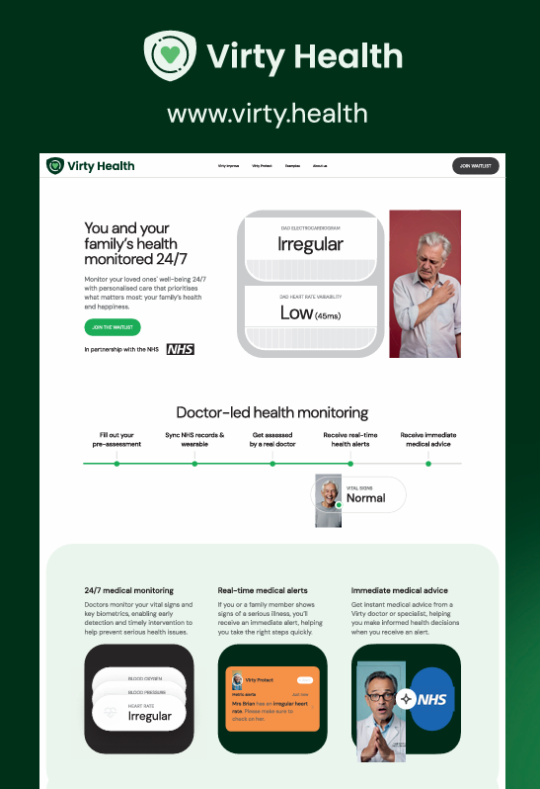
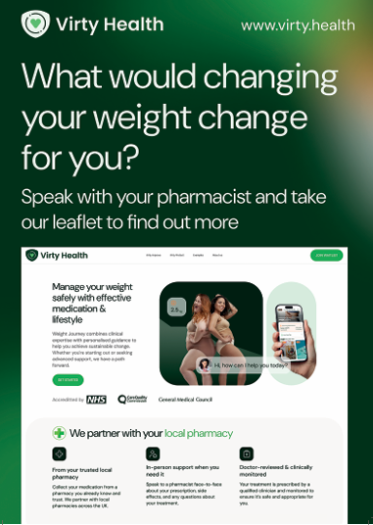
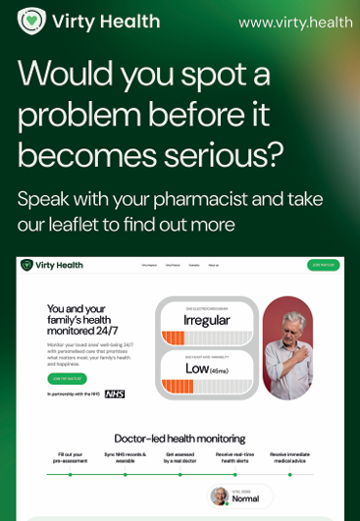
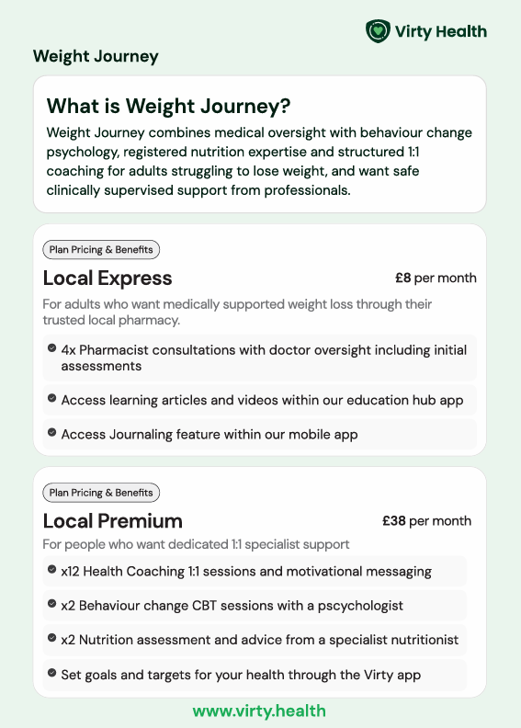
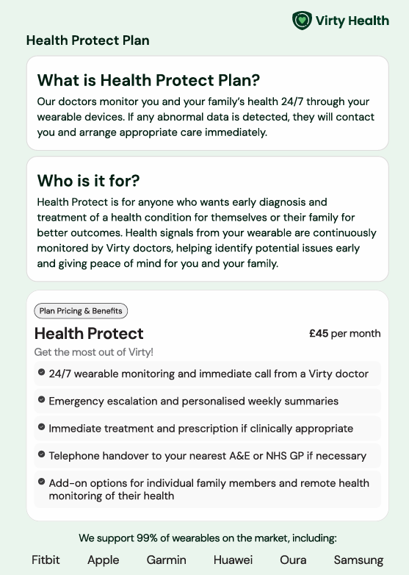



Marketing Resources
Rolling PDF’s and short 10 seconds videos for TV’ / counter tops screens available

Slide 20
We look forward to continuing this opportunity with you

