Slide 1

Wellness and Wellbeing
A supportive workshop to guide you through life’s challenges
Notes:
1

Slide 2

This is a safe supportive space
Please take care of yourselves
Confidentiality
Please use this as a space to reflect
I invite you to look at things from a different angle (sitting in a different chair)
Please be respectful of others’ perspectives
This Photo by Unknown Author is licensed under CC BY-SA
Notes:
2

Slide 3

Mental Health
1 in 4 people will experience a mental health problem of some kind each year in England
1 in 5 people report experiencing a common mental health problem (like anxiety and depression) in any given week in England
About 1 in 5 children and young people aged 8 to 25 in England have a probable mental health problem
We all have mental heath and the sooner we talk about this in a safe space, the sooner we can get to a healthier place
Vicarious trauma & work (exposure to traumatic events) (evidence suggests this can be reduced by 50% if you have embedded wellbeing resources in place)
MIND Statistics
Notes:
3

Slide 4


What does Wellness mean to you?
Is this an area that you think about?
Are all the different buzzwords frustrating, or confusing?
Do you really create space to prioritize your own wellbeing?
Are you too busy to think about this, or put things in place?
Is it a difficult subject to talk about?
Do you look after yourself?
It is ‘Ok’ not to be ‘OK’
The small things are often the big things for your wellness
This Photo by Unknown Author is licensed under CC BY-SA
Notes:
4

Slide 5

How To Stay well at work
(some suggestions)
Nature as a resource (so much on offer and bringing it to you)
Social networks (not isolating yourself)
Creating space for processing
Having a conscious process and self-awareness
‘here and now thinking’
Reflective approaches/models (OK Corral & Drama Triangle)
Creating space to process events (challenges at work)
Appropriate humour ‘laugh-ology’
Wellness Plan (WRAP - What works individually for you)
This Photo by Unknown Author is licensed under CC BY-SA
Notes:
5

Slide 6
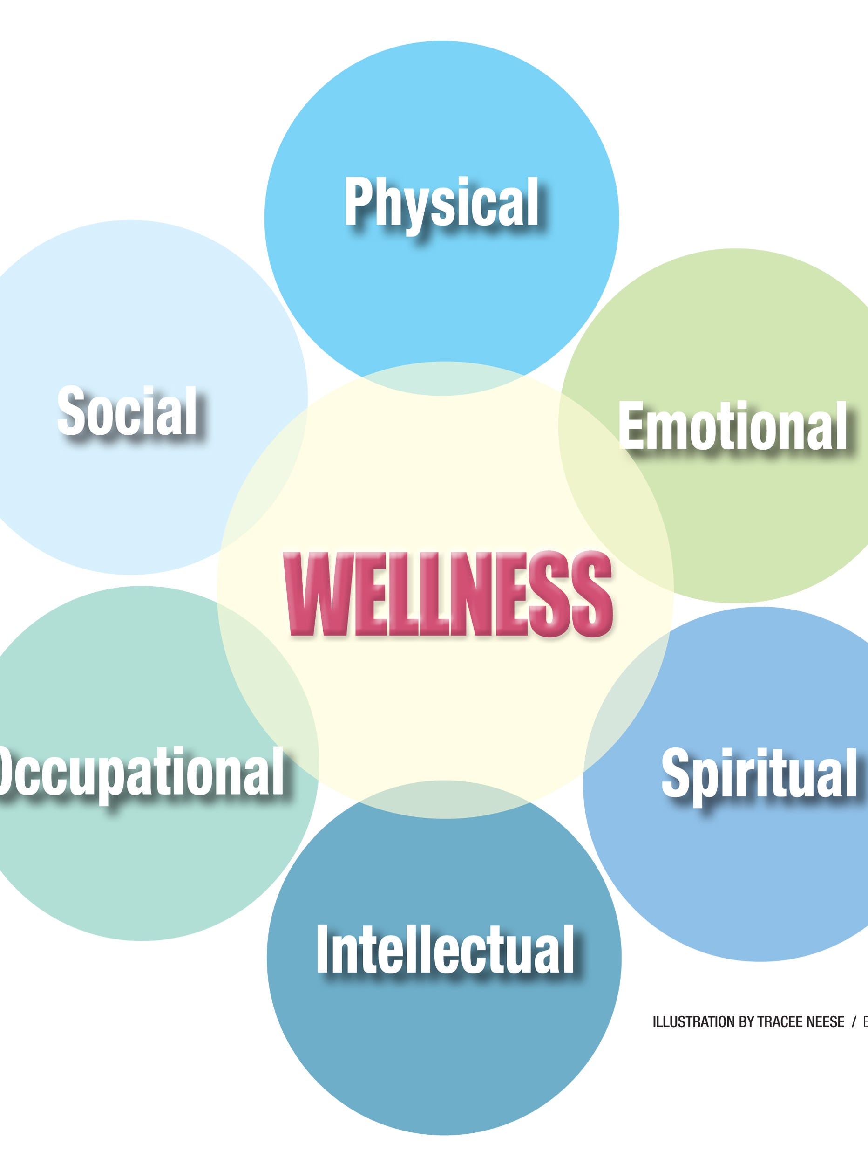
Wellness – what works for you?
Time with loved ones and friends (social connections)
Exercise (walking)
Grounding exercises (breathing/meditation)
Music
Reading
Gardening
Connecting with nature
Notes:
6

Slide 7


What works?-continued
Being aware of your conscious process
Different perspectives and embracing them
Using NLP (Neuro-linguistic programming)to ground yourself
Using 5 minutes a day to focus on your mental health
Looking for the subtle signs that you may not be OK and you could make more time for your wellness
Notes:
7

Slide 8
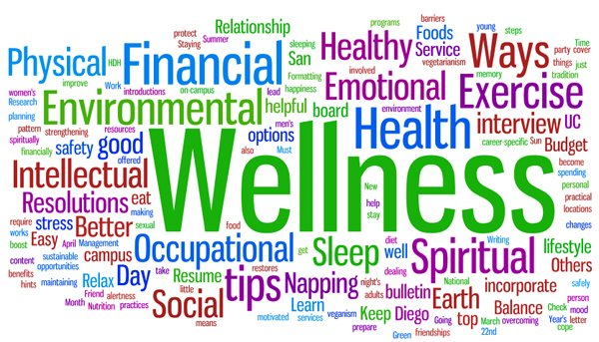
Wellness Discussion
What helps with your wellness?
What can get in the way?
How do you create time?
Is it easy to talk about?
How does wellness become more embedded in your life?
It is ok to not feel ok
Stepping away from technology
Connecting with your values
Getting back to basics
This Photo by Unknown Author is licensed under CC BY
Notes:
8

Slide 9

Dealing with Conflict
Having difficult conversations
Assertive value-based conversations
Contracting
Putting boundaries in place
Connecting with your values in conversations
Feeling isolated and putting steps in place to reduce this
Active listening
Reframing and finding common ground
Staying grounded
Negotiation
Notes:
9

Slide 10


How to process conflict
Create time to talk through conflicts with appropriate colleagues and trusted support networks
Processing time – making time and separating events
CBT techniques
Explore your internal dialogue
Look at impasses and how to move forward (getting stuck)
Creating space after work (separating work and your personal life)
This Photo by Unknown Author is licensed under CC BY
Notes:
)
10

Slide 11

Take aways
Wellbeing is strongly linked to happiness and life satisfaction
It is helpful to have a conscious process of what keeps you well
Being aware of your wellness and nourishing your own needs reduces the chances of experiencing vicarious trauma. (evidence based)
Notes:
#
11

Slide 12

The End Folks

