Slide 1
What market data tells us about the present and the future of community pharmacy
22nd June 2026
Joanne Redding, Director Supplier Relationships, UK Market Intelligence

Slide 2
Agenda
Pressures shaping the Community Pharmacy landscape
NHS Services: room for growth
Patient driven demand for private services
Evolution for the future

Slide 3
Pressures
Opportunities
NHS Capacity
Ageing population
Hospital waiting lists
Access to GP appointments
Operational
Automated and Hub & Spoke dispensing
Supervision changes
Neighbourhood care
Community Pharmacy
Financial
Competition for NHSE budget
Pharmacy contract
Medicines margin
NHS Services
Pharmacy First
Patient advice and halo spend
Independent prescribing
Operational
Dispensing workload
Medicines purchasing
Supply chain disruption and shortages
Patient needs
Private services
Rx to OTC classification
Supporting novel treatments

Slide 4
Pressures on Community Pharmacy

Slide 5
There are fewer pharmacy contractors in England but each is dispensing more items
NHS England – Pharmacy Contractors
Each active pharmacy is now dispensing 1.6k (+22.0%) more items compared to 2022
-6.3%
+14.3%
+22.0%

Slide 6
Increase in the generic concessionary lines signals heightened reimbursement mismatch risk
UK – Retail Pharmacy – Generics
Pharmacies and Wholesalers face elevated margin volatility and inventory level risk

Slide 7
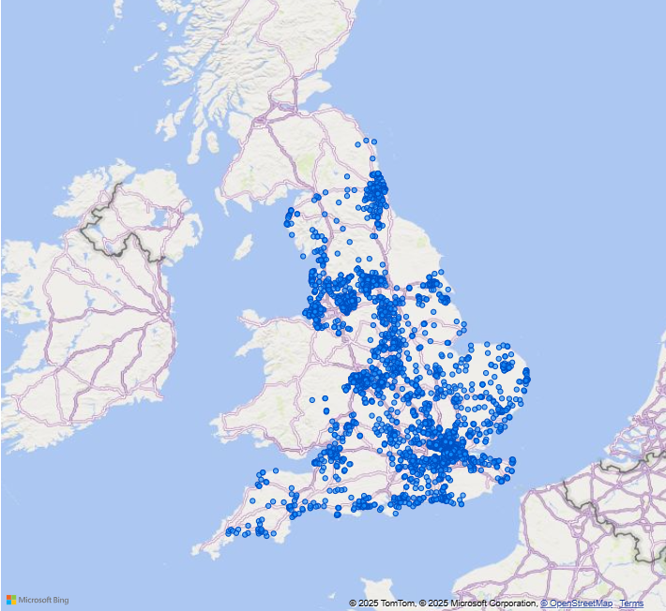
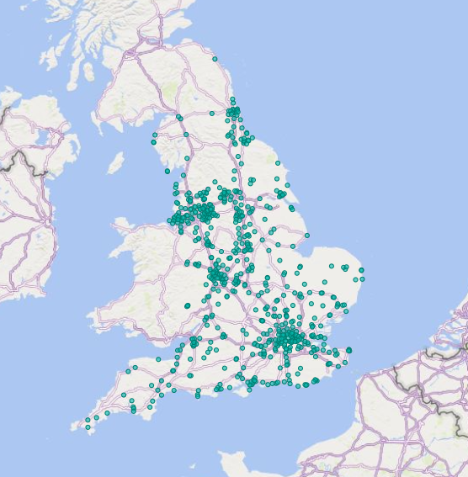
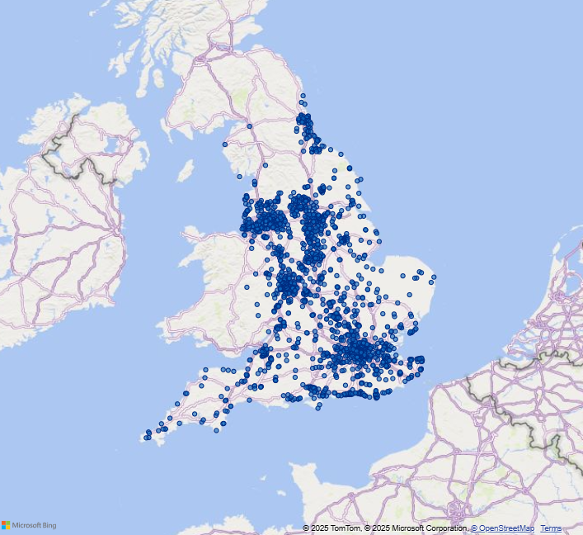
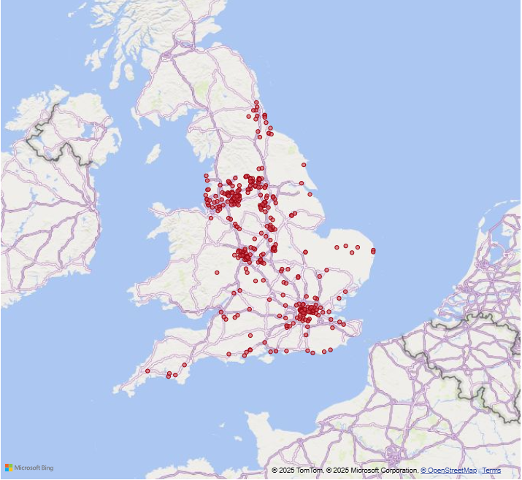
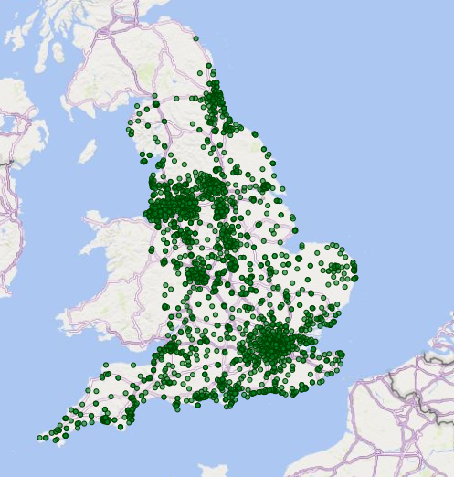
IQVIA groups retail pharmacy contractors into 5 channels based on their geographical distribution and store presence
NHS England – Pharmacy Contractors
Except Distance Selling (DSPs), remaining pharmacies can be classified as B&M
Independents |  | Single pharmacies / chains with 1-5 stores
Regional Chains |  | Pharmacy chains with 6-200 stores Example Lincoln Co-op, Weldricks, etc.
National Chains |  | Pharmacy chains with 200+ stores Includes Boots, Day Lewis, Cohens, Rowlands, Superdrug and Well
Supermarkets |  | Inhouse own-brand pharmacies in supermarkets Includes Asda, Morrison and Tesco
Distance Selling/Internet |  | Pharmacies where Rx are not physically handed in by patients but collected by pharmacy staff, received by post or electronically Example Pharmacy2U, Lloyds Direct, etc.
1
2
3
4
5

Slide 8
Independents continue to grow whereas National Chains have significantly reduced followed by DSPs and Supermarkets
NHS England – Pharmacy Contractors
Store trend by channel
Change in Store Count | YoY (vs. Feb 25) | 5 Years (vs. Feb 22)
Independents | +126 | +952
Regional Chains | -59 | +148
National Chains | -90 | -1731
Supermarkets | -10 | -30
DSPs | -30 | -44
Market | -63 | -705
Store Proportion | YoY (vs. Feb 25) | 5 Years (vs. Feb 22)
 | +1.5% | +11.6%
 | -0.5% | +2.5%
 | -0.7% | -14.0%
 | -0.1% | +0.1%
 | -0.3% | -0.2%

Slide 9
Independents contractors consistently account for the most store openings
NHS England – Pharmacy Contractors – Month (MoM)
In 2025/26, there have been no national chains, supermarket or DSP openings

Slide 10
Expanding NHS services

Slide 11
Pharmacy needs to play a key role in the 3 “key shifts” in that underpin the Government’s 10 Year Health Plan
moving care from hospitals to communities …
1
HOSPITAL
TO
COMMUNITY
focusing on preventing sickness, not just treating it …
2
SICKNESS
TO
PREVENTION
making better use of technology…
3
ANALOGUE
TO
DIGITAL

Slide 12
Delivery of advanced services in community pharmacies has continued to evolve
NHS England – Pharmacy Contractors – Advanced Services
Service fees have changed from Apr 2025 following new NHS England pharmacy contract
Sep 25 – Covid 19 vaccination service launches
Oct 24 – Start of Flu vaccinations delayed from Sep to Oct
Jan 24 – Pharmacy First service launches, replacing CPCS
Apr 23 – Contraception service starts
Apr 25 – NMS reimbursement simplified

Slide 13
On top of the fee per consultation, the fixed payment for 20-29 or 30+ Pharmacy First consultations makes all the difference
NHS England – Pharmacy Contractors (excl DSPs) – Advanced Services
Service | Total
NMS | £1,526
Pharmacy First | £544 +£1,000
BP Checks | £280
Contraception | £275
ABPM | £254
DMS | £175

Slide 14
Chains are delivering more consultations per pharmacy than independents
37% of Independents delivering <20 consultations on average per month
% of pharmacies delivering (Dec 25) | 30.2% | 89.5% | 95.2% | 99.1% | 99.1%
Source: NHSBSA Active Pharmacies delivering >0 consultations, Average consultations per month over 12months to Dec 2025,

Slide 15
Pharmacy First services can help drive ‘Halo Spend’ through higher patient footfall into community pharmacies
Empowered pharmacists, Cross merchandising and Promotions can drive awareness and boost additional customer purchases
Illustration for Sore Throat Treatment
PF Consultation
Advice
Follow-up
Antibiotics Prescribed
Hydration and Rest
Phone /
SMS
Recommend lozenges, throat sprays, pain killers
Suggest electrolyte, probiotic, VMS
Promote immunity supplements
Halo Spend

Slide 16
Patient driven healthcare

Slide 17
As well as increased dispensing and services, private expenditure has tripled in the last year
UK retail and hospital Rx
(publicly reimbursed vs. private; MAT Feb 26)
Persistent NHS crisis creates a gap in meeting patients’ needs
+21.5%
7.2m patients waiting for hospital treatment with 38.5% waiting for over 18 wks
50
45
43.1
40
38.6
Private
35.4
7.0%
35
2.8%
Value (Bn £)
1.3%
30
25
93.0%
Publicly
reimbursed
Average A&E attendance has increased by 22% over the last decade to 74.8k
20
98.7%
97.8%
15
10
5
0
MAT Feb 24
MAT Feb 25
MAT Feb 26
Caveat: Private Rx is not fully captured: products supplied by manufacturers directly or distributed via Third Party Logistics (TPL) companies are excluded.

Slide 18

Limited re-imbursement of GLP1s drives private purchasing
c.60% dispensed through online-only pharmacies
2116k packs in Apr 2026, Mounjaro and Wegovy packs contain 1x Pre-filled syringe with 4 doses for once weekly administration (i.e. 1 pack per patient). N.B. Lilly announced a price rise to Mounjaro on 14th August (effective 1st September) resulting in increased purchasing as a result of patients receiving more than one month’s supply of medication
Mounjaro – indicated for Type 2 diabetes and weight management. NHS usage will be split by Mounjaro’s diabetes and weight management indications
Wegovy – indicated for weight management only
NHSBSA data only available up to Feb 2026 Private reflects all supply for these months

Slide 19
There are 193 obesity medicines in development or marketed with oral Wegovy already having an impact in the US
Obesity pipeline by phase, target and route of administration
Weekly NBRx for Obesity Products
(Jan 2025-Feb 2026)
Jan 2026
Oral Wegovy
80 K
70 K
60 K
50 K
+272%
Number of new to brand per week
40 K
30 K
20 K
10 K
0 K
11/2025
12/25
01/26
02/26
Mounjaro
Zepbound
Ozempic
Wegovy
Source: Citeline Trialtrove; IQVIA Institute, December 2025
Source: US National Prescription Audit, Patient Insights IQVIA

Slide 20



Patients on GLP1s need wrap around advice
  Problems with obesity drugs
  CONSUMER HEALTH OPPORTUNITIES
Lean muscle loss and protein malnutrition
GLP-1 RAs can cause 20–30% lean mass loss during weight reduction. Risk increases with low protein intake.
Targeted product innovation
Develop clinically tailored medical nutrition formulas for GLP-1 users - high-protein, low volume, enriched with key vitamins (B12, D, iron, calcium, etc.).
Anaemia and fatigue
Iron and B12 deficiencies may lead to anemia & neurological symptoms. Metformin use can exacerbate B12 deficiency.
Claim supported marketing
Create evidence-based claims such as: “Helps preserve muscle during weight loss with e.g., GLP-1 RA drugs” or “Supports daily B12 needs while on appetite-suppressing therapy.”
Bone health and osteoporosis
Weight loss reduces bone density; low calcium and vitamin D intake can worsen this.
Digital adherence & tracking tools or partnerships
Integrate digital apps or QR-linked tools that help patients track protein intake, log symptoms, and receive tailored reminders to take supplements. Collaborate with digital prescribing platforms.
Impaired immunity and micronutrient deficits
Deficiencies in zinc, vitamin C, and vitamin A can weaken immunity and delay healing.
Quality of life issues
Rapid weight loss may cause hair thinning and constipation due to low nutrient and fiber intake.
Expanded patient support
Move beyond product to full ecosystem: recipe guides, satiety-friendly meal plans, FAQs for first-time GLP-1 users, and helplines.

Slide 21
Outside of Weight Management, there are other areas of growth in the private market
-0.4%
-4.4%
*Bubble size represents value in MAT Mar 26

Slide 22
Retail pharmacies recorded double digit growth in the travel vaccines* in 2025
Category rises by 27.6% to 886k units in 2025 compared to 2024
Travel Vaccines
Size of travel vaccines category is 0.9m units in 12 months to Dec 2025.
Category purchasing peaks from June to Aug, with a secondary peak in Dec to Jan.
Category has grown by 27.6% in 2025 compared to 2024.
Growth is driven by Rabies, Hepatitis and Typhoid vaccines.
Two new vaccines for Chikungunya have been released in 2025.

Slide 23
Hepatitis, Rabies and Typhoid are the leading travel vaccines categories
All the categories except Dengue have seen an increase in 2025
+12.5% | +79.1% | +15.0% | +23.6% | +39.5% | +15.9% | +38.7% | -10.0% | -
(+34k) | (+89k) | (+23k) | (+18k) | (+19k) | (+3k) | (+5k) | (-1k) | (+2k)
YoY
Growth

Slide 24
The UK ADHD market has grown at a CAGR of 12.5% over the last decade, growing from 2.2m units in 2015 to 6.4m in 2025
ADHD sector has exponentially outgrown total medicines each year
CAGR +12.5%

Slide 25
Evolution for the future

Slide 26
Many areas of exciting innovation lie on the horizon
Illustrative
Key:
Require specialist centres or hospitals
May be administered in community settings
Combination vaccines for respiratory infections
Psychoplastogens
RNA-based gene therapies for high Lp(a)
saRNA Vaccines
Next-gen
anti-depressants
CAR-T cell therapies
CRISPR gene-editing for CVD
Stem cells therapies for PD
AAV-vector gene therapies
Radioligand therapies
Next-gen obesity treatment
Non-traditional Antibiotics
Senolytics
Anti-IL targeting therapies for COPD
Inflammation-targeting therapies for asthma
Microbiome therapies
AMR-relevant vaccines
Recomb. subunit vaccines for EBV
mRNA vaccines for cancer
2024
2025
2026
2027
2028
2029
2030+
Abbreviations: Antimicrobial resistance (AMR), Anti-interleukin (Anti-IL), Chimeric antigen receptor T cells (CAR-Ts), Chronic obstructive pulmonary disease (COPD), Cardiovascular disease (CVD), Epstein-Barr virus (EBV), Monoclonal antibodies (mAbs), Messenger RNA (mRNA), Respiratory syncytial virus (RSV), Self-amplifying RNA (saRNA), Therapies (Tx), Parkinson’s Disease (PD); 2024 Pipeline Review – Innovation for Unmet Need

Slide 27




Key treatment areas identified
Pain
Skin
Allergy
Women's health
Sleep
Oral health
Reduces burden on healthcare services
Pharmacists are a trusted source of advice.
Treatment of minor conditions frees up other parts of the system to focus on more complex cases.
MHRA is encouraging POM to P reclassification.
What is the impact on Community Pharmacy?
Consumer self-care is a growing trend
Shifts in consumer behaviour towards self treatment/selection and purchasing.
Increased accessibility for individuals who may not have easy access to a healthcare provider.
Brand growth and innovation
Growth opportunities for lifecycle management after patent expiry or increase Rx molecule revenue.
Innovation with focus on novel formulations, additional claims and new indications.

Slide 28
Prescribing in Community Pharmacy will evolve
2025/2026
2027/2028
2029
Current services
National Services (Smoking, Contraception), Pharmacy First
56,000 Pathfinder site consultations:
  Fostered collaboration
  94% of patients would recommend
  Minimal low value medicines prescribing (<0.5%)
Safe access to medicines and advice
Autumn 2026 – Prescribing within Pharmacy First and Contraception Service and up to 5 new pathways
Sept 2026 - registration of first c.2,800 graduates with IP
Single National Formulary expected to be completed by 2027
Future Opportunities
Neighbourhood integration to support Long Term Condition (CVD, Respiratory) e.g add first line treatment to BP check service
Transition from local commissions
Underpinned by clinical governance and supervision, skill mix, digital infrastructure and funding

Slide 29
The workforce is starting to change in response to the future needs of community pharmacy
Over half of IP qualified pharmacists are prescribing and increased numbers of technicians and accuracy checkers will enable the shift in role responsibilities

Slide 30



The Pharmacy of the future will be central to patient care
Care & services
Convenience
Technology
From dispensing led to clinically led neighbourhood care
Clinically Focused
Patient Centric
Digitally Connected

Slide 31
Community Pharmacy evolution
Core Dispensing
Pressures on dispensing income and supply chains, means pharmacies need to optimise operations and/or diversify.
1
NHS & Private Services
NHS services will expand further to drive the 3 shifts in the 10-year plan whilst patients will drive the need for private services and advice.
2
Future opportunities
Community Pharmacy will be involved in more treatment areas through new P-medicines and independent prescribing
3
Implications
Pharmacies will need to evolve to meet the needs of their communities. Service models, staffing mix and technology are key enablers.
4

Slide 32
For further questions, please contact:
Joanne Redding (Joanne.Redding@iqvia.com)

