Slide 1

The landscape for pharmacy and how we can change it
Monday 22 June
Baldev Raj Bange: Treasure for the National Pharmacy Association

Slide 2


Slide 3



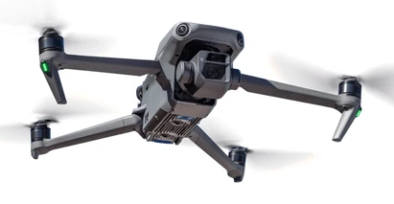

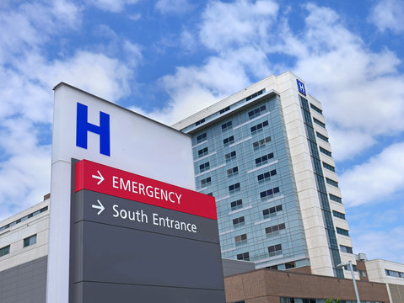

Our landscape
Notes:
Fiscal challenges
Role of AI
Medicine supply chain problems
New ways of delivering medicines (drones, Amazon, hub and spoke etc)
Independent prescribing
Left shift

Slide 4
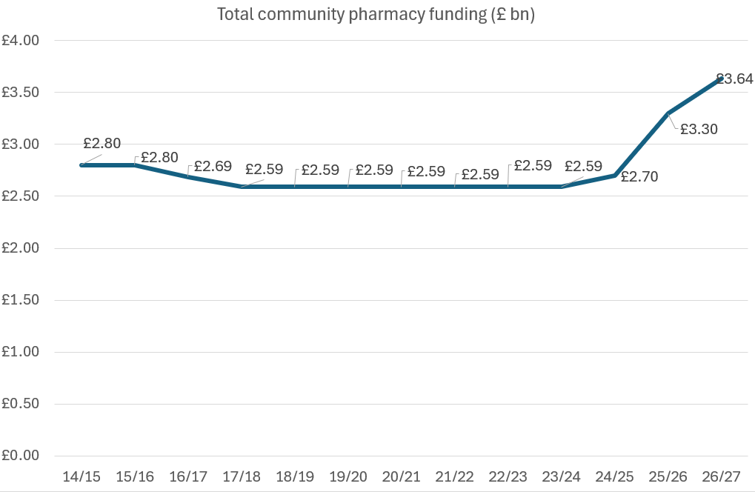
Recent uplifts in England

Slide 5
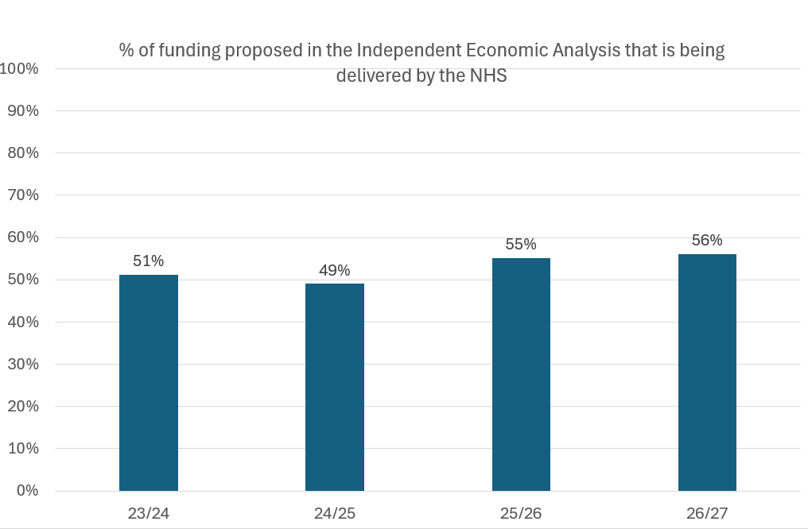
But still short of what is required

Slide 6



Slide 7
Profit Generated in NHS Dispensing & Services
Profit & Loss Report
Purchase Profit | £69,760.44
Fees and NHS Services Income | £154,744.05
Total NHS Income | £224,504.49
Staff Costs Associated with NHS Dispensing | £222,935.90
Profit (excluding Flu and Covid) | £1,568.59
Other Costs (90%) | £53,555.70
Loss (excluding Flu and Covid) | -£51,987.10
Flu and Covid Vaccination Income | £32,739.58
Loss (Including Flu and Covid) | -£19,247.53

Slide 8
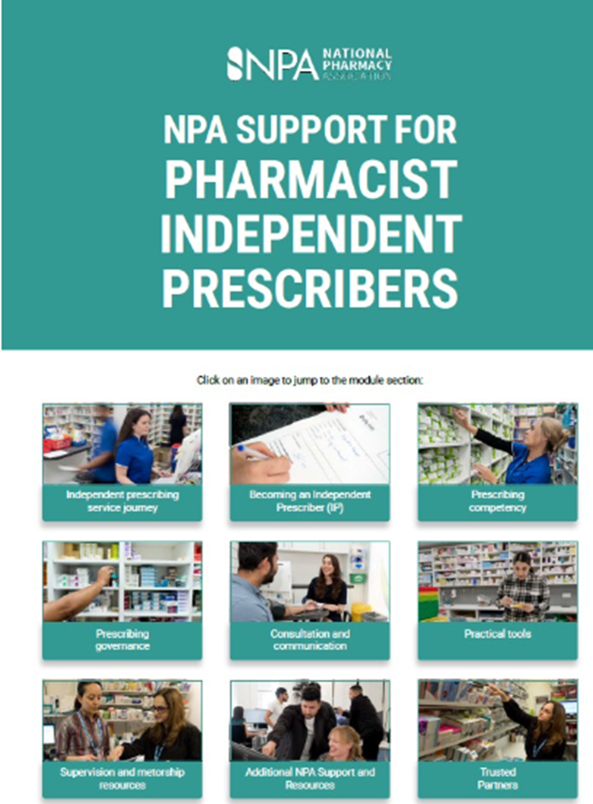



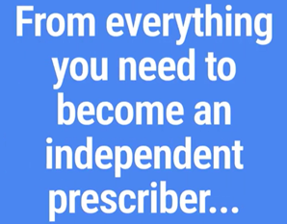
Notes:
QR Code take you to a survey Sharing your views on prescribing in community pharmacy Help the NPA understand current experiences, opportunities and barriers around prescribing in community pharmacy. Earn a CPD certificate for your time.
Member support - comprehensive IP pack with resources and templates to support safe prescribing practice .
Jasmine kindly shared the following:
Independent Prescribing Service Resources
•SOP
•Risk Assessment template
•Prescribing policy template
•Record Keeping guidance and template
•Audit Guidance and Template
•Medical History Consultation Checklist template
•Clinical notes and abbreviations guide
•Prescribing Incident Protocol
•Prescribing Service Checklist
•Pharmacy First Plus SOP Scotland
•Prescribing Service GP Engagement Template Letter
•Prescribing Service GP Summary Template Letter
•Prescribing Service Business Continuity Plan Template
•Prescription template
Prescribing Competency Resources
•Prescribing Competency Assessment and Declaration
•Independent Prescribing Expanding Scope of Practice Guide
•Independent Prescribing and Prescribing Service FAQs
NPA Guidance
•Knowledge Article: Independent Prescribing Principles
•Knowledge article: Prescribing and supplying weight management medicines – including prescribing risks, remote consultations, key considerations
•Knowledge article: Patient Group Directions versus Independent Prescribing
•Knowledge article: Propranolol prescribing safety update
•NEW: NPA Guidance: Antimicrobial prescribing and competency framework
•NPA and NPA Insurance position statement – GLP-1 medicines and risk of pancreatitis
•NPA and NPA Insurance position statement – prescribing and supply of GLP-1 medicines
•SUPERINTENDENT UPDATE: supplying weight loss treatment – balancing clinical safety vs. cost
•SUPERINTENDENT UPDATE: supplying weight loss treatments – your clinical queries answered

Slide 9
Contract reform
Inequitable delivery of margin
Clawback
Branded generics
Reliance on referrals for clinical services
Price variation risk carried by pharmacy
Growth in volume
Medicine shortages
Lack of alignment with GP contract
Dispensing at a loss
Restrictions on amending prescriptions
Funding fails to cover costs

Slide 10
Campaign
Support
Connect

Slide 11

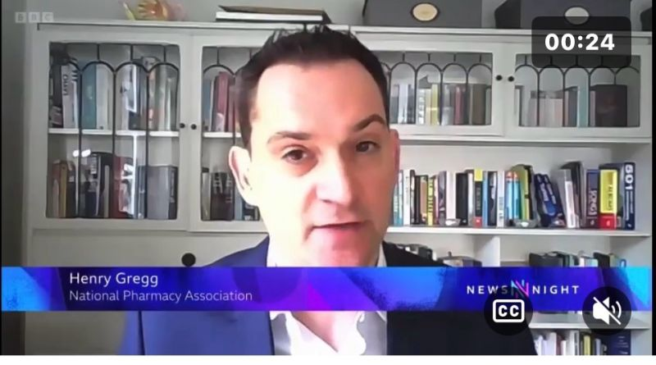
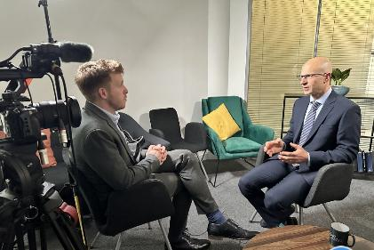
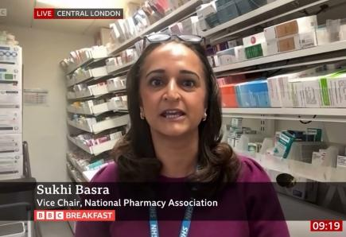
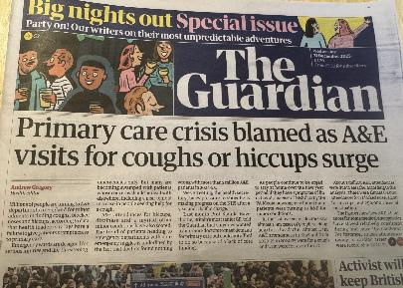

Slide 12

Award-winning Gold Standard NPA Insurance
Telephone Advice Line and NPA Advisory
NPA Membership Hub
Learning and Development
Business Support and Trusted Partners
News and Events

Slide 13


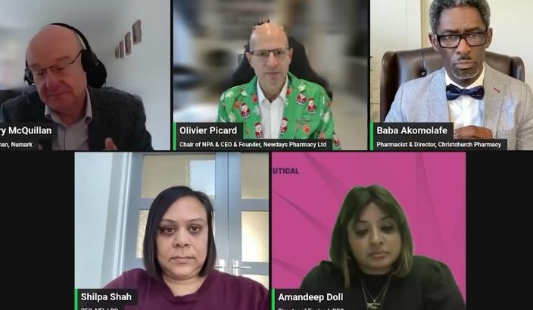


Slide 14
The contract

Slide 15
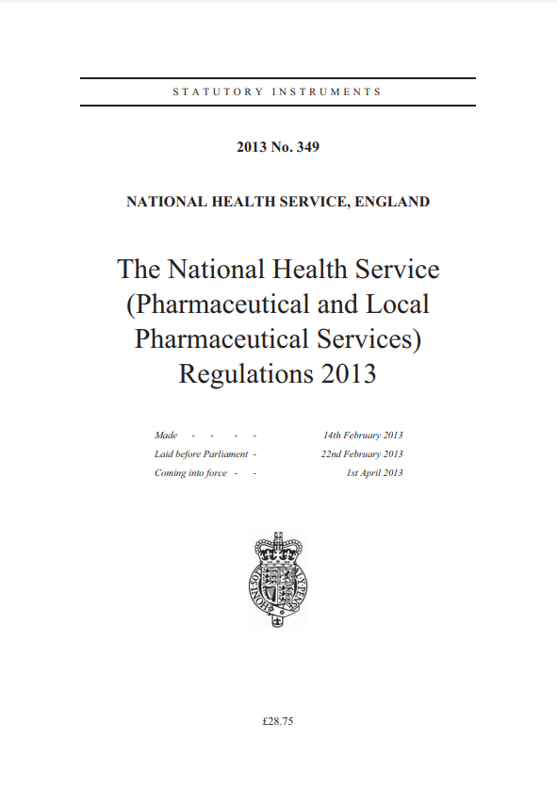

Community Pharmacy Contractual Framework
Terms of Service
  Essential Services e.g. dispensing with advice, eRD, records, support for self care, prescription-linked interventions, disposal, SSP, safeguarding, Discharge Medicines Service
  Clinical Governance e.g. lead, audits, patient safety & incidents, business continuity, NHS Mail, DSP Toolkit, safeguarding
  Healthy Living e.g. health champions, outreach health promotion, campaigns
Advanced Services (national opt in) – New Medicines Service, Vaccinations (flu), Contraception, Hypertension case finding, Pharmacy First* (urgent medicines, minor illness +7 clinical pathways), Smoking Cessation on Discharge, LFT, Appliance Use Review, Stoma Customisation
Enhanced Services (local) e.g. COVID vaccine, health checks, prescribing (also Local Authority commissioning of supervised consumption, needle exchange, chlamydia testing etc)
Pharmacy Quality Scheme (opt in) e.g. inhaler technique, overuse of β- agonists, antimicrobial stewardship, palliative care medicines access, clinical audit of Pharmacy First
Pharmacy Access Scheme - small payment for being only pharmacy in a geography
*Pharmacist prescribing to be added to Pharmacy First in Autumn 2026

Slide 16
Pharmacy Contract
Items dispensed per pharmacy up 37% in 10 years.
~1100 pharmacy closures in past 10 years.
Clinical services absorbed within negative real terms funding growth*.
May not substitute suitable alternative e.g. caps for tabs without reissued prescription.
Pharmacies must purchase all medicines and are retrospectively reimbursed.
No NHS pension
No government indemnity
No core IT (provider pays)
No premises costs or rates relief
No ARRS staff funding
Can provide private services.
Past 10 years CPCF fixed sum
 | 16/17 | 17/18 | 18/19 | 19/20 | 20/21 | 21/22 | 22/23 | 23/24 | 24/25 | 25/26 | 26/27
Year-on-year uplift | -4.0% | -3.5% | 0.0% | 0.0% | 0.0% | 0.0% | 0.0% | 0.0% | 4.1% | 15.0% | 10.3%
Real terms uplift year on year* | -5.9% | -4.7% | -2.2% | -2.6% | -5.0% | -0.2% | -6.6% | -5.0% | 0.0% | 11.4% | 8.1%

Slide 17
Thank you
Sunday 28 June

Slide 18
What Next…
Talk
Bal – 07539012299
Notes:
Services
Viewing our profession as clinicians
Skin crypotherapy - skin tags, warts
Contact GPs and other local service providers or community centres
How are you going to make your patients aware of your services?
Local Advertising
Website
Social Media – use your staff to advertise on their FB/Instagram
Leaflets
Staff word of mouth
Staff social media
GP surgery engagement - can you provide them with anything that lists your services – mousemats etc
Utilise IT and staff:
PMR
Mens Health: Hair Loss, Erectile Dysfunction, alcohol reduction, Back pain, Conjunctivitis, Haemorrhoids, Urinary Incontinence, Premature Ejaculation, Nausea and Sickness
Women’s Health: Period Delay, Alcohol reduction, facial hair removal, HPV Period Pain, Thrush, UTI treatment
Microneedling
Skin peeling
Iv drips
Period Delay – £20-£27 depending on days needed
Cost is approx. £5-£6
Allergy Clinic
In particular during hayfever season
Review of allergy profile
Pharmacist led and need an IP can prescribe if required (or use PGDs)
Phlebotomy
Partnered with Nationwide lab (training required)
Charged at the end of the month the agreed fee per service by the lab
Pharmacy charges £40 for a blood draw
Pharmacy charges £60 for Hepatitis B tests
Once trained, it takes 10 minutes with the patient
Menopause Clinic
Set up to offer women a private consultation to discuss their health needs
1 hour appointment to allow enough time for a full past medical history to be taken
Requires an IP with experience in women’s health
Dermatology Clinic
30 minutes appointment to look at any skin condition
Often involves a discussion about emollients (OTC)
Which can be with a member of the pharmacy team, but uses IP for prescription items

