Slide 1


Healthy Living Pharmacies
Milton Keynes
"delivering exceptional public health services through exceptional teams in exceptional premises that meet local needs"
Beccy White
Public Health, Milton Keynes Council

Slide 2
MK branding
Short film showing overview of HLP - Aston HLP
Notes:
OVERVIEW/INTRODUCTION TO HLP

Slide 3
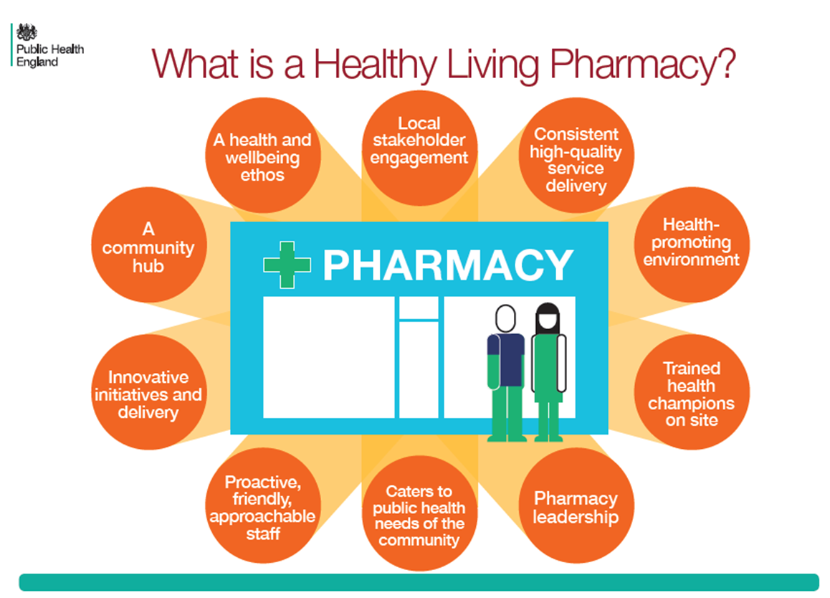
What is a HLP
Notes:
LOVELY INFOGRAPHIC HIGHLIGHTING THE APPROACH

Slide 4
What distinguishes a HLP
Consistently delivers broad range of high quality services
Quality, innovation and productivity
Proactive team ethos
Trained RSPH level 2 Health Champion
Identifiable by public
Achievement of Quality Criteria
HLP Quality mark

Slide 5
Components of a HLP
Notes:
Level one expected to offer:
Stop smoking Services
Chlamydi
MUR’s (medicine use review)
NMS (new medicine service)

Slide 6
MK HLP history
2011- 2012
Part of Pathfinder, PCT led, 5/47 settings accredited, scheme lapsed
2016
LA PH led in partnership with LPC and supported by MKCCG
33/47 settings trained so far
re-launch October

Slide 7

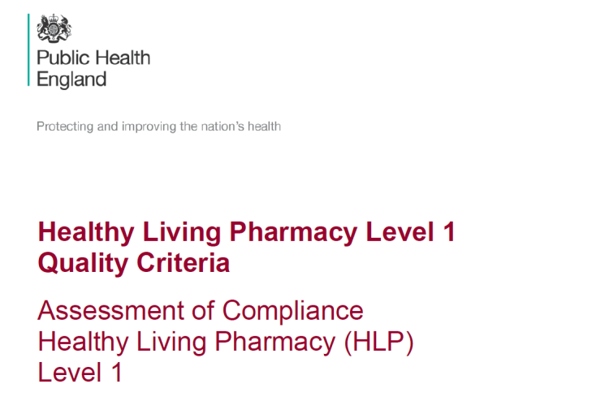
Strategic – national steer
'Reducing Premature Mortality: the Role of Community Pharmacies‘ Report
2015 RSPH
3 key roles for the community pharmacy of the future:
3/3 - As the neighbourhood health and wellbeing hub –
becoming the ‘go-to’ destination for support, advice and resources on staying well and living independently.
Notes:
As selection not exhaustive

Slide 8
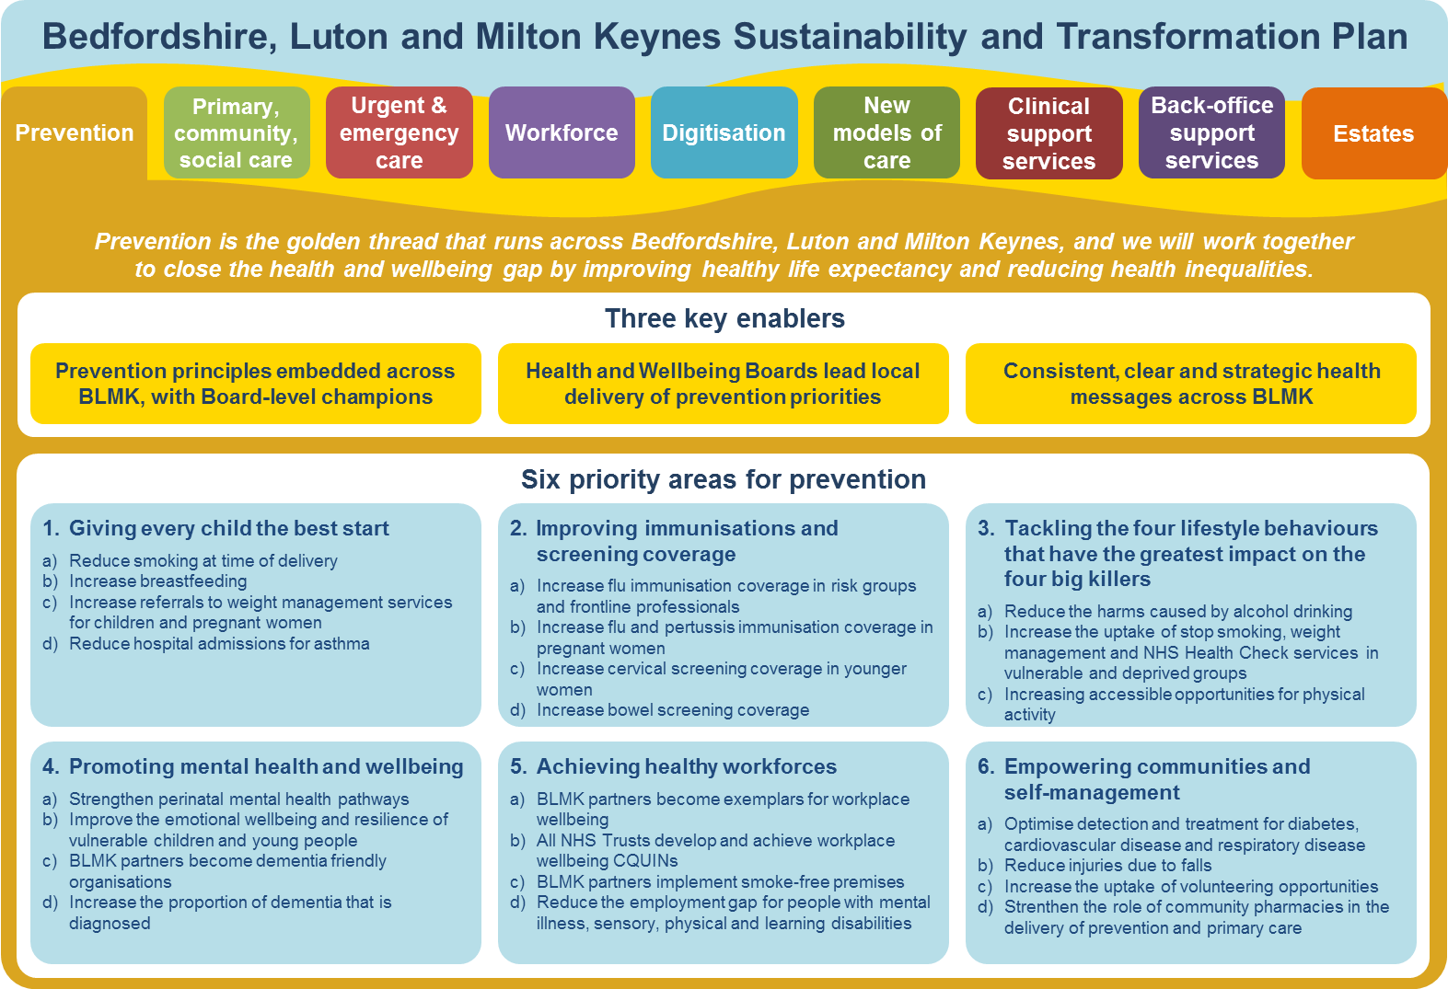
Strategic – local steer
Support gaps identified in PNA
Increase uptake of existing commissioned services
Increase profile of CP…increase footfall = increase revenues
Ability to demonstrate to both present and future commissioners what community pharmacy can deliver
Notes:
STP footprint BEDS, Luton and MK
Joining up HLP framework
Examples of gaps identified in the PNA:
Smoking cessation gaps: Increase delivery in level 2 services, community based outreach and sign-posting
Sexual Health gaps: Improve uptake of Chlamydia screening & Emergency Hormonal Contraception especially in teenage hot spot wards, campaigns to raise awareness of and improve HIV screening
Long Term Conditions (LTC) gaps: Monitoring & screening services for early detection of LTCs
Mental health, alcohol & drug misuse, weight management, Older People gaps

Slide 9
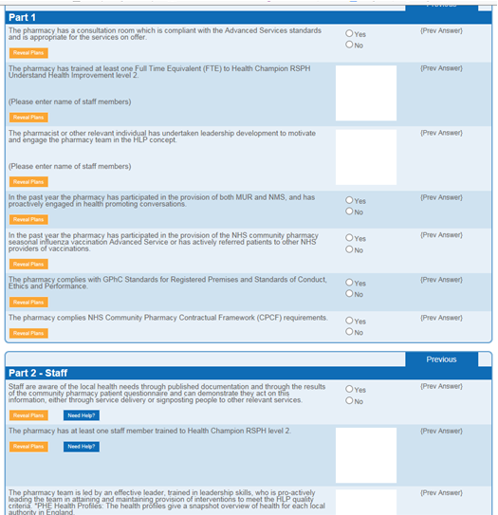
MK HLP Process
Training
Self Assessment
  Part 1
  Part 2
  Part 3
Audit for
accreditation

Slide 10
MK HLP Process
Training
Leadership training for Pharmacists or senior staff 12th October
Health Champion network 20th October
On-line RSPH level 2 training
Communications
GP’s - supporting
Public – Leader of the Council launching

Slide 11
MK HLP Process
Self Assessment Audit
Part 1 – 7 questions to progress to part 2
Part 2 - workforce development, engagement and environment sections.
Develop action plan
Collect part 2 evidence for portfolio
Think about delivery of present PH services in your pharmacy…innovation

Slide 12
MK HLP process
Audit for accreditation
Currently MKC, LPC or CCG HLP assess
Audit self assessment evidence.
Sign part 3 ‘declaration of compliance’
Record outcomes
Think how are you going to differentiate yourself as a HLP and make a difference in your locality
Notes:
National quality assurance on the horizon

Slide 13
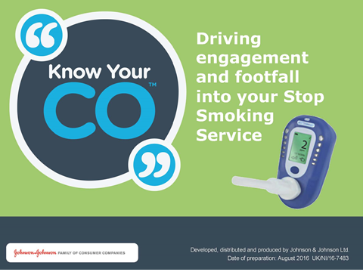
MK HLP next steps
Start the HLP journey!
Health Promotion Zone – 6 campaigns a year. Launch with Stoptober – Know your CO2
HLP Resources

Slide 14

Any ‘burning’ questions?

